Slide 1
Systems Engineering System Design Update
Team Members:
Ander Solorzano
Stephen Smith
Jaghvi Mehta
Matt Clark

Slide 2
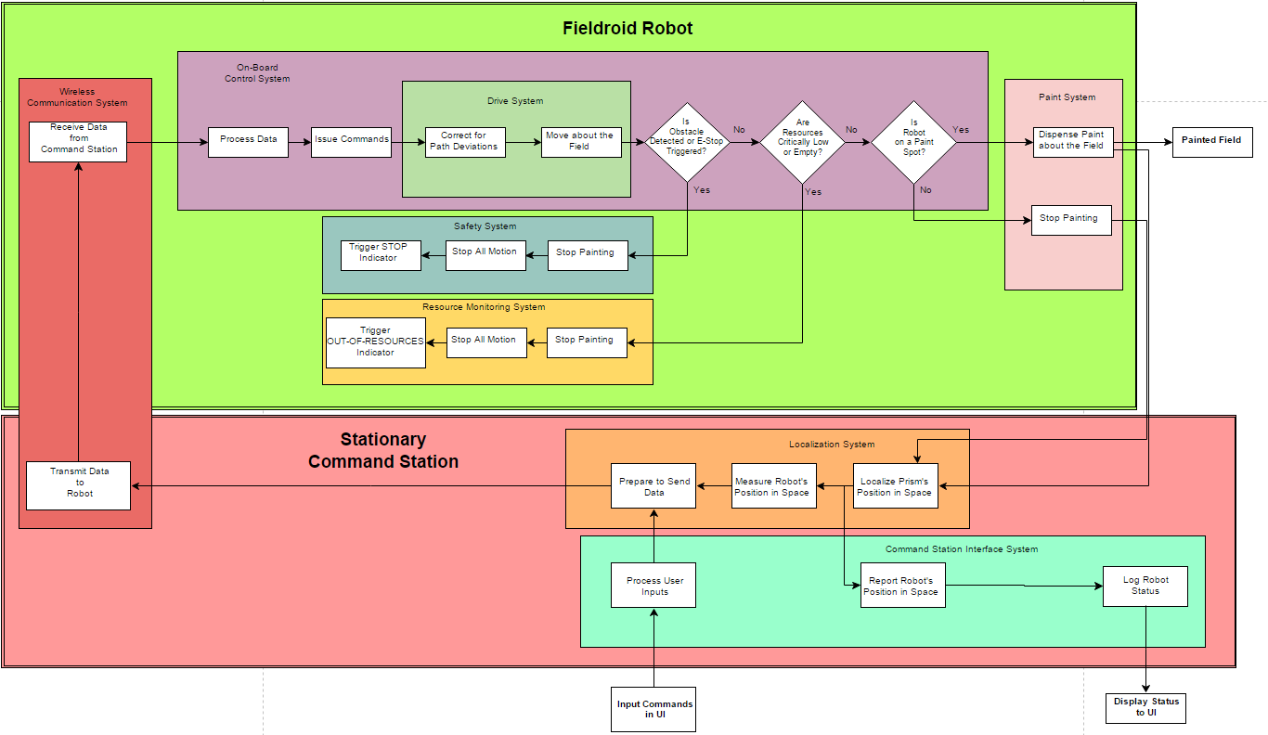
Functional Architecture

Slide 3
F.A. – Communication Systems

Slide 4
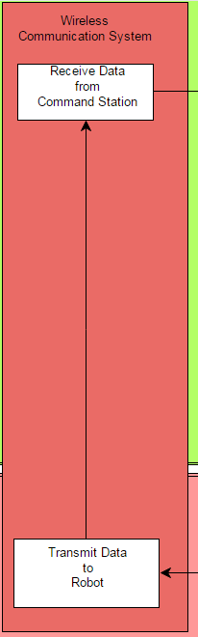
F.A. – Communication Systems

Slide 5
F.A. – Control, Safety, Monitoring, and Paint Systems

Slide 6
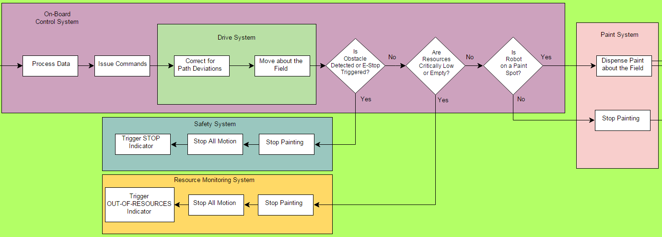
F.A. – Control, Safety, Monitoring, and Paint Systems

Slide 7
F.A. – Localization and UI Systems

Slide 8
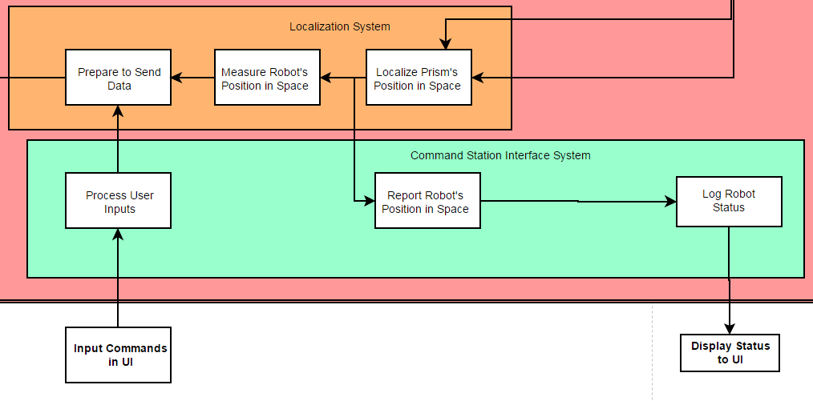
F.A. – Localization and UI Systems

Slide 9
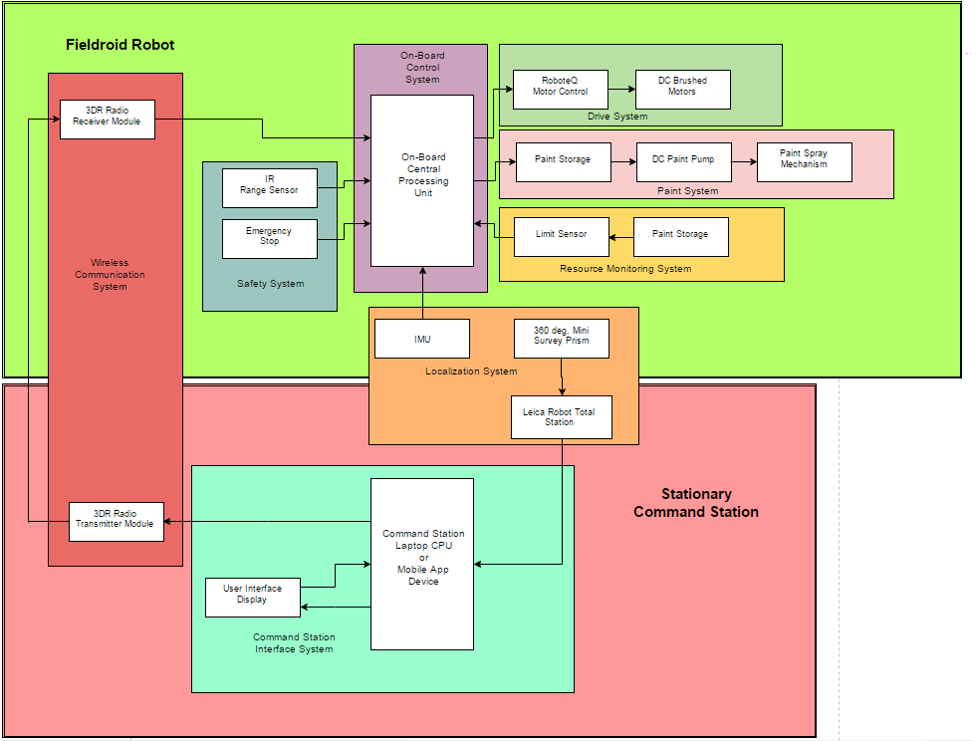
Physical Architecture

Slide 10
P.A. – Fieldroid Subsystems

Slide 11
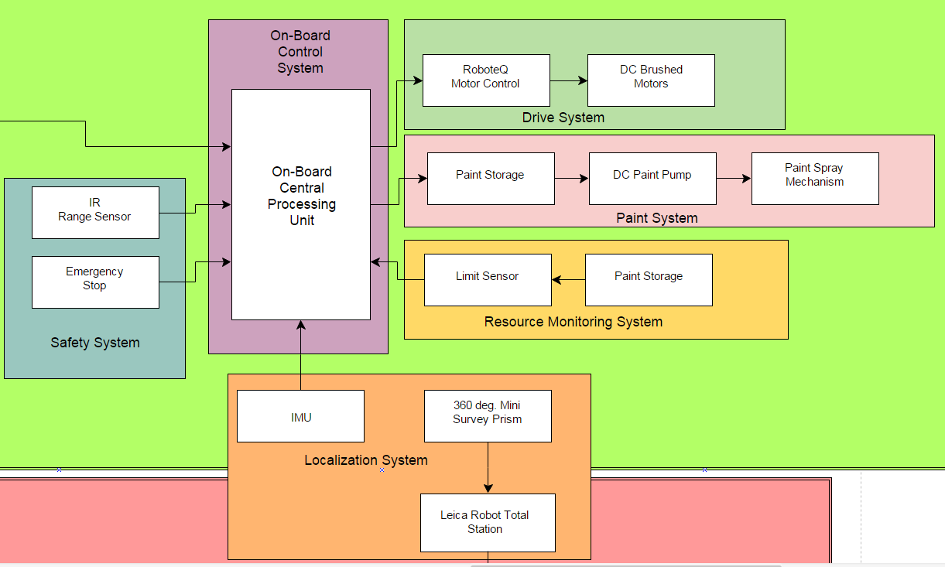
P.A. – Fieldroid Subsystems

Slide 12
P.A. – Command Station Subsystems

Slide 13
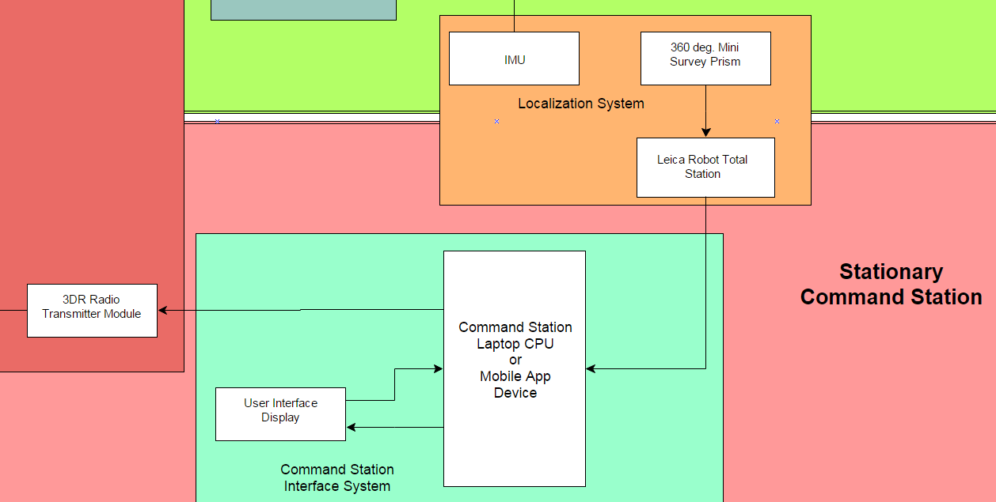
P.A. – Command Station Subsystems

Slide 14
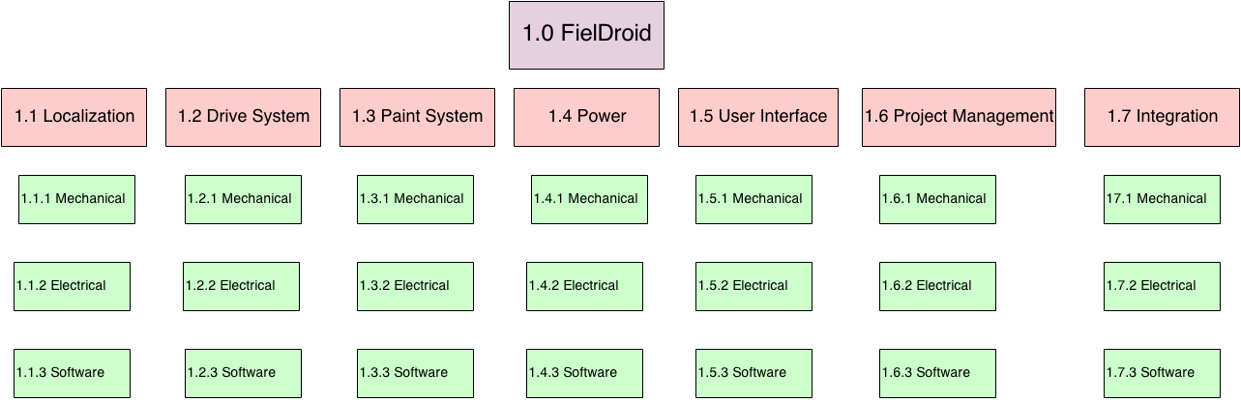
Work Breakdown Structure

Slide 15
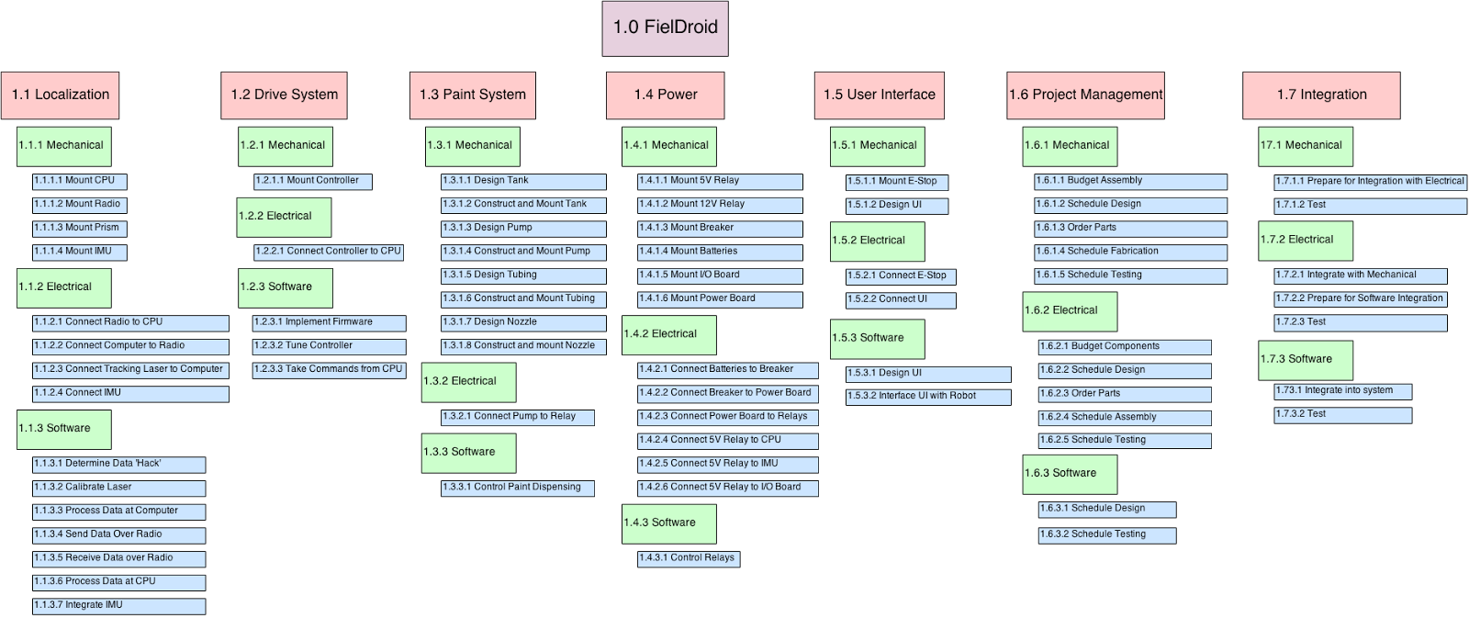
Work Breakdown Structure

Slide 16
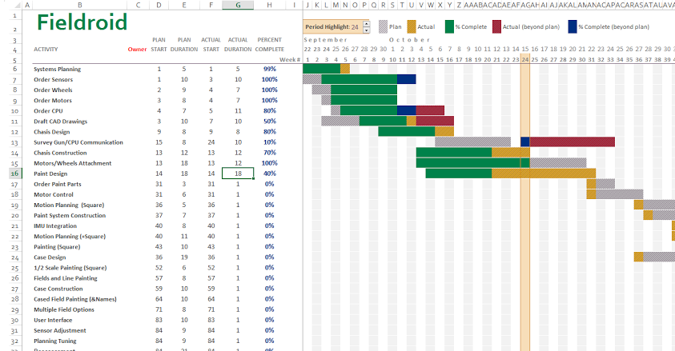
Work Breakdown Structure

Slide 17
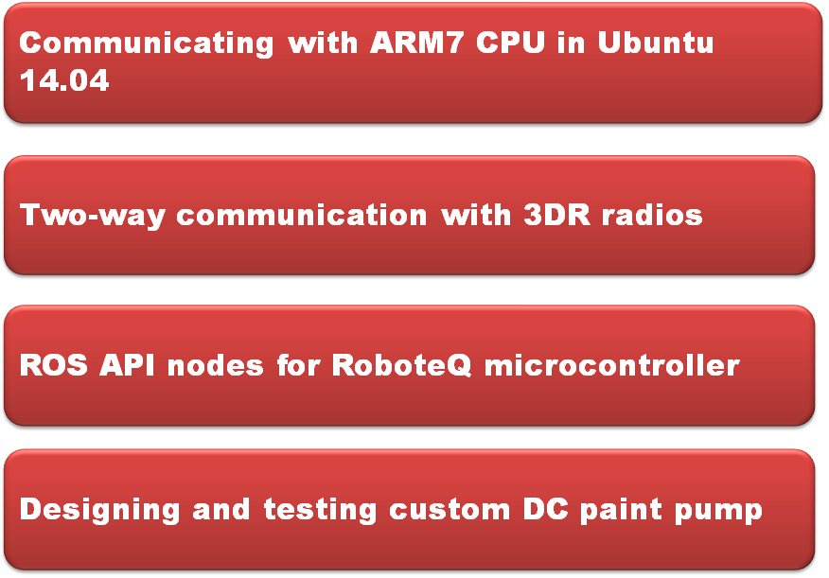
Technical Challenges

Slide 18
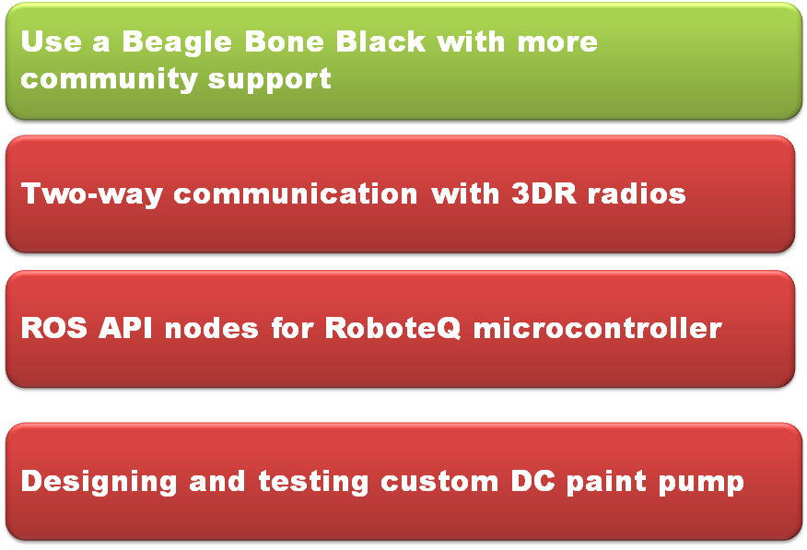
Technical Challenges

Slide 19
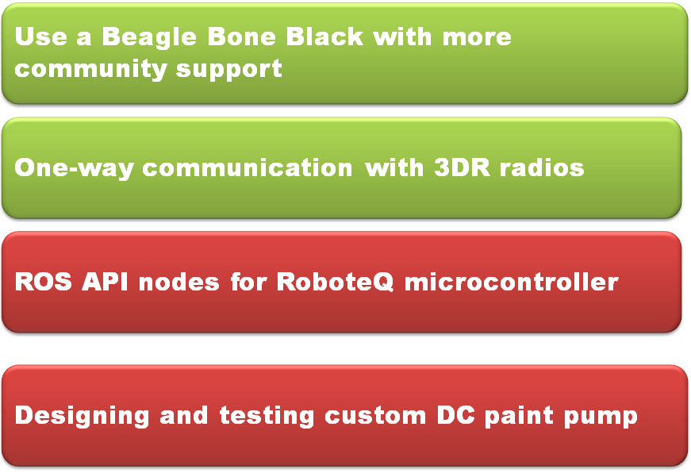
Technical Challenges

Slide 20
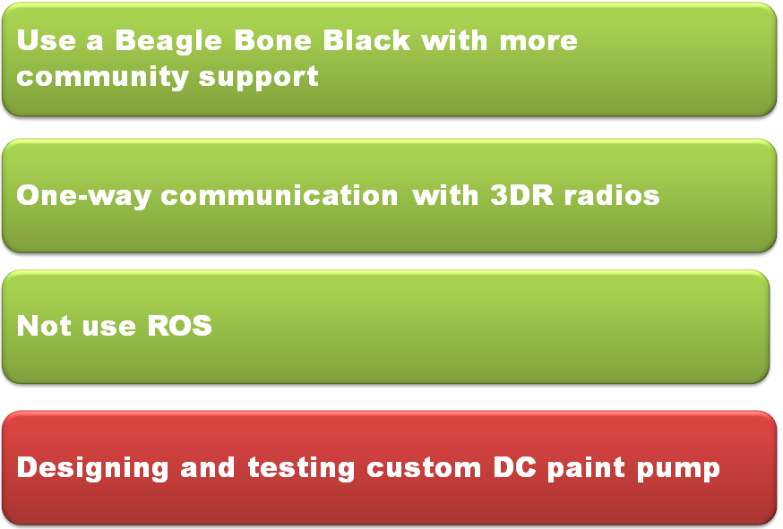
Technical Challenges

Slide 21
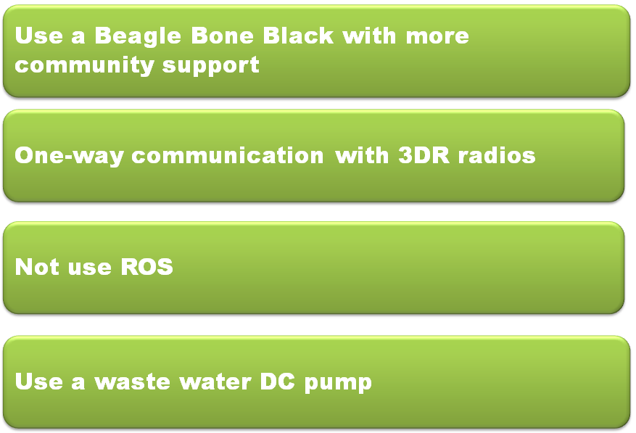
Technical Challenges

Slide 22
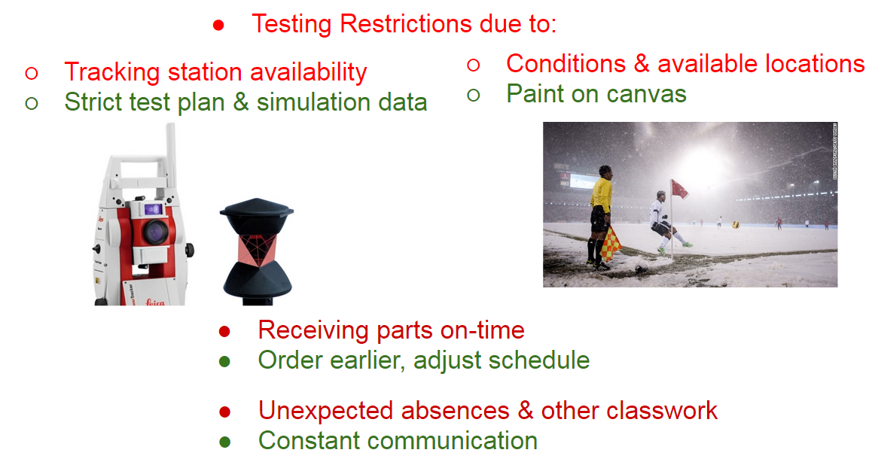
Project Management Challenges

Slide 23
QUESTIONS

Slide 24
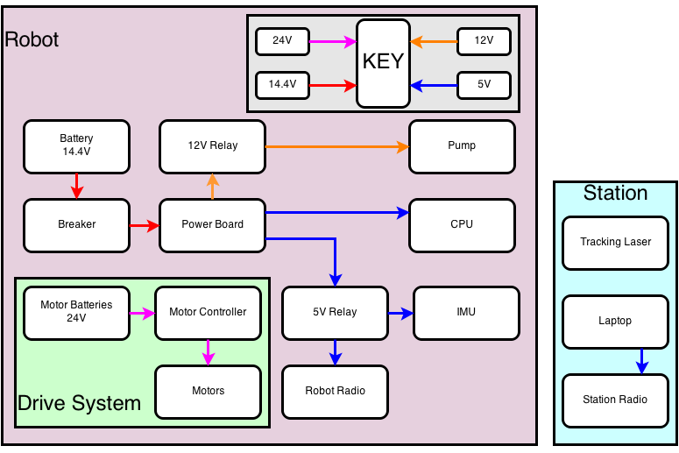
Back Up – System Power Diagram

Slide 25
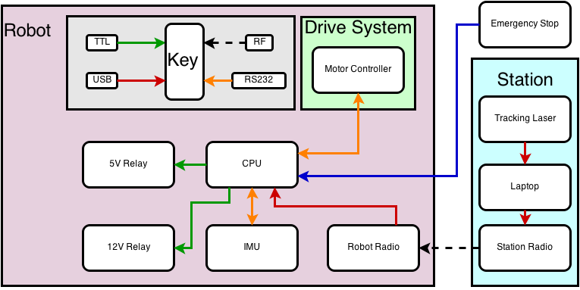
Back Up – System Signals Diagram

